Slide 1
Introduction to Data Analytics DSE-2151 B.tech Data Science & Engineering 3rd Semester Introduction to DA
Rohini R. Rao & Manjunath Hegde
Dept of Computer Applications
Sept 2021
(Slide set 1 out of 5)

Slide 2
Contents
Evolution of database systems
Need for making sense of data
Definition
Data science
Data Analytics
Steps to data analysis
Stage – 1 Problem Definition
Stage – 2 Data Preparation
Stage – 3 Implementation of the Analysis
Stage – 4 Deployment
Case study
Case study 1 : Google Flu trends
Case study 2 : Breakfast Cereal Data Set

Slide 3
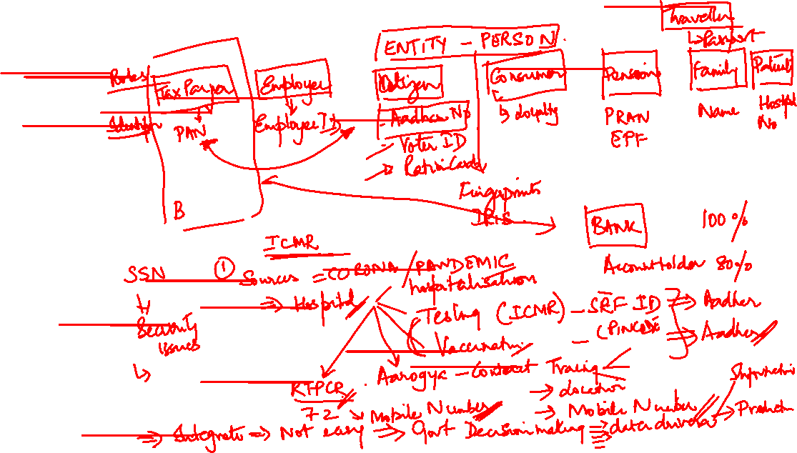
Datafication

Slide 4
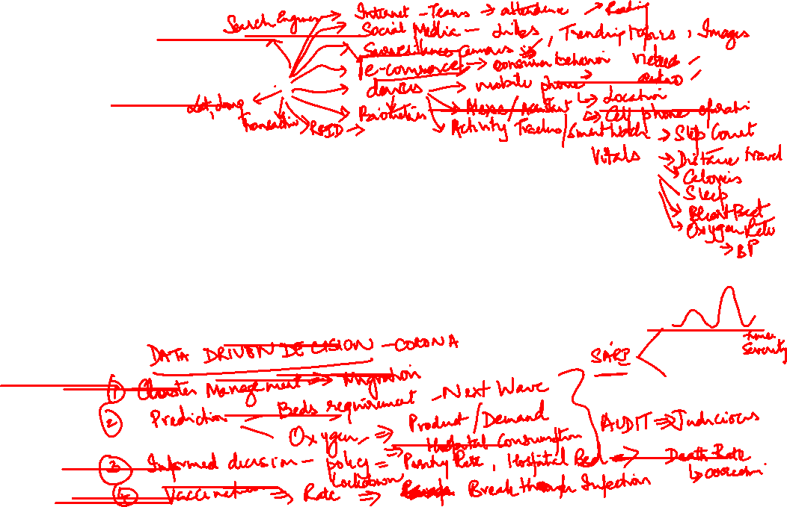
Datafication
Every phenomena is being observed and stored
People and devices are connected to the grid
Internet of things is growing faster than Internet of people
Kryder’s law says that the density and capacity of hard drive storage media will double every 18 months
Data is stored in more detailed resolution, more variables are being captured and stored

Slide 5
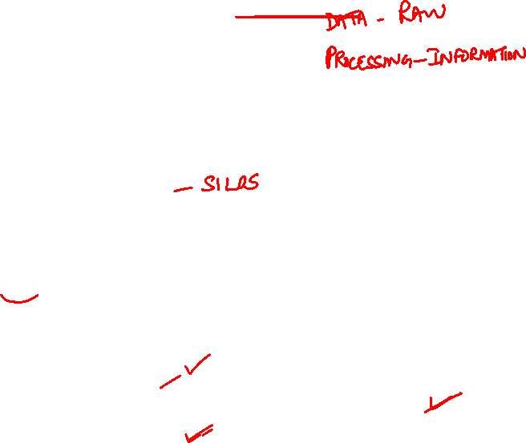
Need for making sense of data
unprecedented amount of data is being generated
Data rich but information poor situation
Data repositories becomes Data tombs
So decision making was based on intuition rather than information
Expert systems rely on domain experts to manually input system knowledge to knowledge bases
Leads to information overload
Need for making sense of the data
the analysis of data includes
Summarizing and interpret the data
how to identify nontrivial facts, patterns, and relationships in the data
how to make predictions from the data.

Slide 6
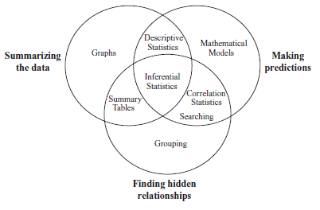
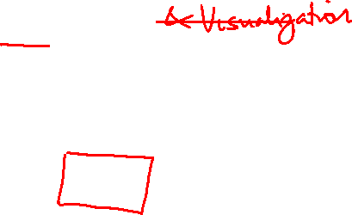
Definition - Data Analytics
is the science of examining raw data with the purpose of drawing conclusions about that information.
To make better business decisions
in the sciences to verify or disprove existing models or theories.
Consists of
exploratory data analysis (EDA)
confirmatory data analysis (CDA)
Qualitative data analysis (QDA)
Data Analysis tasks & methods

Slide 7
Your Inputs
dfsdafjasdlk

Slide 8
To become a Data Analyst: (Expected industry requirements)
Programming skills:
Knowing programming languages are R and Python
Statistical skills and mathematics:
Descriptive and inferential statistics and experimental designs are a must for data scientists.
Machine learning skills
Data wrangling skills:
The ability to map raw data and convert it into another format that allows for a more convenient consumption of the data.
Communication and Data Visualization skills
Data Intuition:
it is extremely important for professional to be able to think like a data analyst.

Slide 9
Definition - Data science includes
refers to analytics and data mining in every applicable domains
Includes
Computer science:
Internet technology , graph theory, distributed architectures such as Hadoop, computer programming (Python, Perl, R) and processing sensor and streaming data
Statistics:
design of experiments including multivariate testing, cross-validation, sampling,
Machine learning and data mining
Operations research
Business intelligence, OLAP

Slide 10
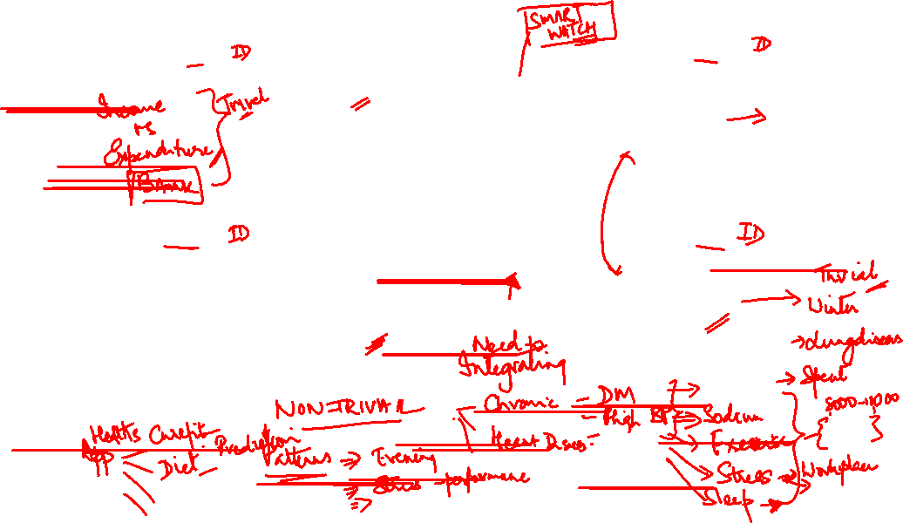
MOTIVATING EXAMPLE
…
…
Employee
Passenger
Works in
Travels in
Company
Airline
Customer
…
Patient
…
Buys from
Treated by
Supermarket
PERSON
Hospital
QUESTION : ????

Slide 11
Steps in data analysis projects
Problem Definition
Objectives
Data Preparation
Implementation of the Analysis
Summarizing the data
Deployment
Plan and execute deployment based on the definition in step 1
Deliverables
Roles and responsibilities
Current situation
Timeline
Costs and benefits
Pull together data table
Categorize the data
Clean the data
Remove unnecessary data
Transform the data
Partition the data
Finding hidden relationships
Making prediction
Review the project
Measure and monitor performance

Slide 12
Steps in a data analysis project Step 1– Problem Definition
1.1. Objectives
to define the business or scientific problem to be solved
Helps to create a focused plan to execute
Success criteria for the project should be defined and measurable
Collection of suitable information must be available
For example: Make recommendations to improve sales on the web site by a specific amount. Sub Objectives are:
Identify categories of web site users (on the basis of demographic information) that are more likely to purchase from the web site.
Categorize users of the web site on the basis of usage information.
Determine if there are any relationships between buying patterns and web site usage patterns.
1.2. Deliverables
Will the solution be a report, a computer program to be used for making predictions, a new workflow or a set of business rules
When developing predictive models, it is useful to understand any required level of accuracy
It is also important to understand the consequences of answering questions incorrectly.
In many situations, the time to create a model can have an impact on the success of the project

Slide 14
Steps in a data analysis project Step 1 – Problem Definition
1.3. Roles and responsibilities
Project leader: responsible for putting together a plan and ensuring the plan is executed.
Subject matter experts and/or business analysts: have specific knowledge of the subject matter or business problems including
(1) how the data was collected,
(2) what the data values mean,
(3) the level of accuracy of the data,
(4) how to interpret the results of the analysis,
(5) the business issues being addressed by the project.
Data analysis/data mining expert: familiar with statistics, data analysis methods and data mining approaches as well as issues of data preparation.
IT expert: expertise in pulling data sets together (e.g., accessing databases, joining tables, pivoting tables, etc.) as well as knowledge of software and hardware issues important for the implementation and deployment steps.
Consumer: will use the information derived from the data in making decisions, either as a one-off analysis or on a routine basis.

Slide 15
Steps in a data analysis project Step 1 – Problem Definition
1.4. Current situation
Define the constraints on the project
The sources and locations of the data to be identified.
Privacy or legal issues to be listed.
1.5. Timeline
Preliminary implementation plan should be put together.
Time to be set aside for iteration of activities as the solution is optimized
1.6. Costs and benefits
budget based on the plan could be used, alongside the business success criteria, to understanding the cost/benefits for the project

Slide 16
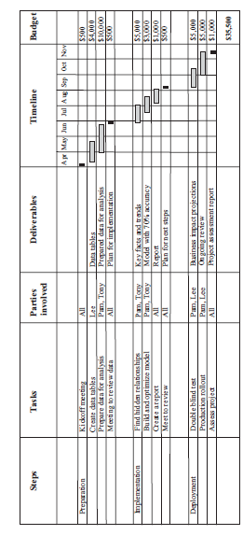
Sample Project timeline

Slide 17
Steps in data analysis projects
Problem Definition
Objectives
Data Preparation
Implementation of the Analysis
Summarizing the data
Deployment
Plan and execute deployment based on the definition in step 1
Deliverables
Roles and responsibilities
Current situation
Timeline
Costs and benefits
Pull together data table
Categorize the data
Clean the data
Remove unnecessary data
Transform the data
Partition the data
Finding hidden relationships
Making prediction
Review the project
Measure and monitor performance

Slide 18
Steps in a data analysis project Step 2 – Data Preparation
2.1. Pull together data table
2.1.1. Query databases to access data
2.1.2. Integrate multiple data sets and format as a data table
Data sources include:
Surveys or polls – sampling & bias
Experiments - For example, when studying the effects of a new drug, a double blind study is usually used
Observational and other studies – when unethical to get experimental data
Operational database
Data warehouse or Historical data base
Purchased data base

Slide 19
Steps in a data analysis project Step 2 – Data Preparation Data Sources

Slide 20
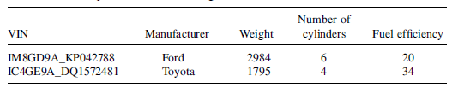
Steps in a data analysis project Step 2 – Data Preparation
2.1. Pull together data table
Data sets :
contain data objects which represents an entity
Data object is described by data fields called attributes
Attributes are also called as dimension, feature , variable
Values for a given attribute is observation
A set of attribute values are also called as attribute vector

Slide 21
What is a Data Warehouse ?
provides architectures and tools for business executives to systematically organize, understand and use their data to make strategic decisions.
Separate from organization’s operational databases.
Supports information processing by providing a solid platform of consolidated historical data for analysis.
A semantically consistent data store that serves as a physical implementation of a decision support data model and stores that information on which an enterprise needs to make strategic decisions.

Slide 22
Data Warehouse Architecture

Slide 23
Data warehouse key features
According to Willian H. Inmon , a Data Warehouse is
Subject- oriented
Integrated
Time-variant
Non-volatile
Data warehousing is the process of constructing and using data warehouses.
Information from data ware houses are used to support business decision-making activities such as
(i) increasing customer focus – customer buying patterns
(ii) repositioning products and managing product portfolios – production strategies
(iii) analyzing operations and looking for sources of profit
(iv) managing the customer relationships , making environmental corrections and managing the cost of corporate assets.

Slide 24
Characteristics of Data Warehouse:
Subject-oriented:
means that all data pertinent to a subject/ business area are collected and stored as a single unit
Integrated:
means that data from multiple disparate sources are transformed and stored in a globally accepted fashion
Static/non-volatile:
means data once entered into the warehouse does not change frequently. It is periodically updated if required
Time variant:
Data warehouse maintains historical data which are used to analyse the business or market trends and facilitate future predictions

Slide 25
Data Warehousing Terminology
Data sources:
An organization has many functional units with their own data which has to be consolidated and put into a consistent form that would reflect the business of an organization as a whole..
Metadata:
Metadata is the information about the data.
This is the layer of the data warehouse which stores the information like the source data, transformed data, date and time of data extraction, target databases, data and time of data loading, etc.
Measure attributes:
A numerical value that can be summarized or can be aggregated upon.
Dimension attributes:
Dimensions can be defined as the perspectives used for looking at the data.

Slide 26
Conceptual Modeling of Data Warehouses
Modeling data warehouses: dimensions & measures
Star schema: A fact table in the middle connected to a set of dimension tables
Snowflake schema: A refinement of star schema where some dimensional hierarchy is normalized into a set of smaller dimension tables, forming a shape similar to snowflake
Fact constellations: Multiple fact tables share dimension tables, viewed as a collection of stars, therefore called galaxy schema or fact constellation

Slide 27
Example of Star Schema
time
time_key
day
day_of_the_week
month
quarter
year
item
item_key
item_name
brand
type
supplier_type
Sales Fact Table
time_key
item_key
branch_key
branch
location
location_key
branch_key
branch_name
branch_type
location_key
street
city
province_or_street
country
units_sold
dollars_sold
avg_sales
Measures

Slide 28
Example of Snowflake Schema
time
item
time_key
day
day_of_the_week
month
quarter
year
item_key
item_name
brand
type
supplier_key
supplier
Sales Fact Table
supplier_key
supplier_type
time_key
item_key
branch_key
branch
location
location_key
location_key
street
city_key
branch_key
branch_name
branch_type
units_sold
city
dollars_sold
city_key
city
province_or_street
country
avg_sales
Measures

Slide 29
Example of Fact Constellation
time
time_key
day
day_of_the_week
month
quarter
year
item
Shipping Fact Table
item_key
item_name
brand
type
supplier_type
Sales Fact Table
time_key
time_key
item_key
shipper_key
item_key
branch_key
from_location
branch
location_key
location
to_location
branch_key
branch_name
branch_type
units_sold
location_key
street
city
province_or_street
country
dollars_cost
dollars_sold
units_shipped
avg_sales
shipper
Measures
shipper_key
shipper_name
location_key
shipper_type

Slide 30
From Tables and Spreadsheets to Data Cubes
A data warehouse is based on a multidimensional data model which views data in the form of a data cube
A data cube, such as sales, allows data to be modeled and viewed in multiple dimensions
Dimension tables, such as item (item_name, brand, type), or time(day, week, month, quarter, year)
Fact table contains measures (such as dollars_sold) and keys to each of the related dimension tables
In data warehousing literature, an n-D base cube is called a base cuboid. The top most 0-D cuboid, which holds the highest-level of summarization, is called the apex cuboid. The lattice of cuboids forms a data cube.

Slide 31
A Sample Data Cube
Date
Total annual sales
of TV in U.S.A.
1Qtr
2Qtr
3Qtr
4Qtr
sum
Product
TV
PC
U.S.A
VCR
sum
Canada
Country
Mexico
sum
All, All, All

Slide 32
Multidimensional Data
Sales volume as a function of product, month, and region
Dimensions: Product, Location, Time
Hierarchical summarization paths
Region
Industry Region Year
Category Country Quarter
Product City Month Week
Office Day
Product
Month

Slide 33
Cuboids Corresponding to the Cube
all
0-D(apex) cuboid
product
date
country
1-D cuboids
product,date
product,country
date, country
2-D cuboids
3-D(base) cuboid
product, date, country

Slide 34
Steps in a data analysis project Step 2 – Data Preparation
2.2 Categorize the data
Constant: A variable where every data value is the same.
Example - PI
Dichotomous: A variable where there are only two values
Example- Gender whose values can be male or female.
Discrete, Categoric or Nominal: A variable that can only take a certain number of values (either text or numbers).
Example- the variable Color where values could be black, blue, red etc.
Continuous: A variable where an infinite number of numeric values are possible within a specific range.
Example- temperature between the minimum and maximum temperature, the variable could take any value

Slide 35
Steps in a data analysis project Step 2 – Data Preparation
2.2. Categorize the data
Scales of measurement
Nominal: Scale describing a variable with a limited number of different values. The order of these values has no meaning.
Ordinal: This scale describes a variable whose values are ordered, the difference between the values does not describe the magnitude of the actual difference.
For example, a scale where the only values are low, medium, and high
Interval: Scales that describe values where the interval between the values has meaning.
For example, when looking at three data points measured on the Fahrenheit scale, 5 F, 10 F, 15 F. Interval scales do not have a natural zero.
Ratio: Scales that describe variables where the same difference between values has the same meaning (as in interval) but where a double, tripling, etc.
For example of a ratio scale is a bank account balance whose possible values are $5, $10, and $15

Slide 36
Steps in a data analysis project Step 2 – Data Preparation
2.2 Categorize the data
Roles in analysis
Labels: Variables that describe individual observations in the data.
Descriptors:
These variables are almost always collected to describe an observation
They are also described as predictors or X variables.
Response:
These variables (usually one variable) are predicted from a predictive model (using the descriptor variables as input).

Slide 37
Steps in a data analysis project Step 2 – Data Preparation
2.3. Clean the data
in order to help improve the quality of data and consequently of the mining results.
data quality, including accuracy, completeness, consistency, timeliness, believability, and interpretability.
Data analyzed may be
Incomplete – no recorded values , lacking attribute values or containing only aggregate values
Noisy – containing errors or outliers
Inconsistent – containing discrepancies in the department codes used to categorize items

Slide 38
Steps in a data analysis project Step 2 – Data Preparation 2.3. Data Cleaning as a process
Steps in the Data Cleaning Process are
Discrepancy Detection
- Can be caused by
Poorly designed data entry forms
Human error in data entry
Deliberate errors
Data Decay
inconsistent use of codes and any inconsistent data representations
To detect discrepancies
use Meta Data
use descriptive data summaries
can also be done with Data scrubbing tools which use simple domain knowledge to detect errors
Data auditing tools analyze data to discover rules and relationships and detect data that violate these rules
Data Transformation
Some inconsistencies can be corrected manually using external references
Data Migration tools and ETL tools may have GUIs to perform transformation
The two step process is iterative

Slide 39
Steps in a data analysis project Step 2 – Data Preparation 2.3. Data Cleaning for Missing values
Missing Values
Ignore the tuple
Fill in the missing value manually
Use the global constant to fill in the missing value – ‘unknown’ – can result in overfitting
Use the attribute mean to fill in the missing value
Use the attribute mean for all samples belonging to the same class as the given tuple.
Use the most probable value to fill in the missing value.

Slide 40
Steps in a data analysis project Step 2 – Data Preparation 2.3. Data Cleaning for Noisy Data
Noisy Data- Noise or outlier is a random error or variance in a measured variable.
Rule of thumb
1.5 * IQR above Q3 or below Q1 is an outlier
2 standard deviations away from mean
Binning
Smoothens a sorted data value by consulting its neighborhood.
The sorted values are distributed into a number of buckets or bins
Also called as local smoothing
- Smoothing by bin means
- Smoothing by bin median
- Smoothing by bin boundaries
Regression
Data can be smoothed by fitting the data to a function
Clustering
Outliers can be detected by clustering
Inconsistent Data - can be detected by analyzing the meta data

Slide 41
Example 1 : Data Smoothing
4,8,15,21,21,24,25,28,34
Equi-Depth Partitioning of depth or bin size=3
Bin 1 : 4, 8, 15
Bin 2 : 21, 21, 24
Bin 3 : 25, 28, 34
Smoothing by Bin Means
Smoothing by Bin Boundaries

Slide 42
Example 2 – Data Cleaning
Suppose that the data for analysis includes the attribute ‘age’.
A. Perform data cleaning using 5-number summary
13,15,16,16,19,20,20,21,22,22,25,25,25,25,30,33,33,35,35,35, 35, 36,40,45,46,52,70
Using Rule of thumb - IQR
Upper Bound:
Lower Bound:
Using Rule of thumb - SD
Min | Q1 | Q2 | Q3 | Max

Slide 43
Example 2 – Data Cleaning
Suppose that the data for analysis includes the attribute ‘age’.
A. Perform data cleaning using 5-number summary
13,15,16,16,19,20,20,21,22,22,25,25,25,25,30,33,33,35,35,35, 35, 36,40,45,46,52,70
B. Smoothen the data using bin means into bins of depth 3
Min | Q1 | Q2 | Q3 | Max

Slide 44
Steps in a data analysis project Step 2 – Data Preparation
2.4. Remove the unnecessary data
Constants to be removed
Variables with too many missing data points should be considered for removal.
Redundant variables to be removed
Analysis of the correlations between multiple variables may identify such variables

Slide 45
Steps in a data analysis project Step 2 – Data Preparation
2.5. Transform the data
applying mathematical transformations to the data for further analysis or mining
Methods include
2.5.1. Normalization
process where numeric columns are transformed using a mathematical function to a new range
2.5.2. Value mapping
To convert variables from one form to another
2.5.3. Discretization
where the raw values of a numeric attribute (e.g., age) are replaced by interval labels (e.g., 0–10, 11–20, etc.) or conceptual labels (e.g., youth, adult, senior).
2.5.4. Aggregation
where summary or aggregation operations are applied to the data
For example, the daily sales data may be aggregated so as to compute monthly and annual total amounts.

Slide 46
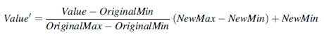
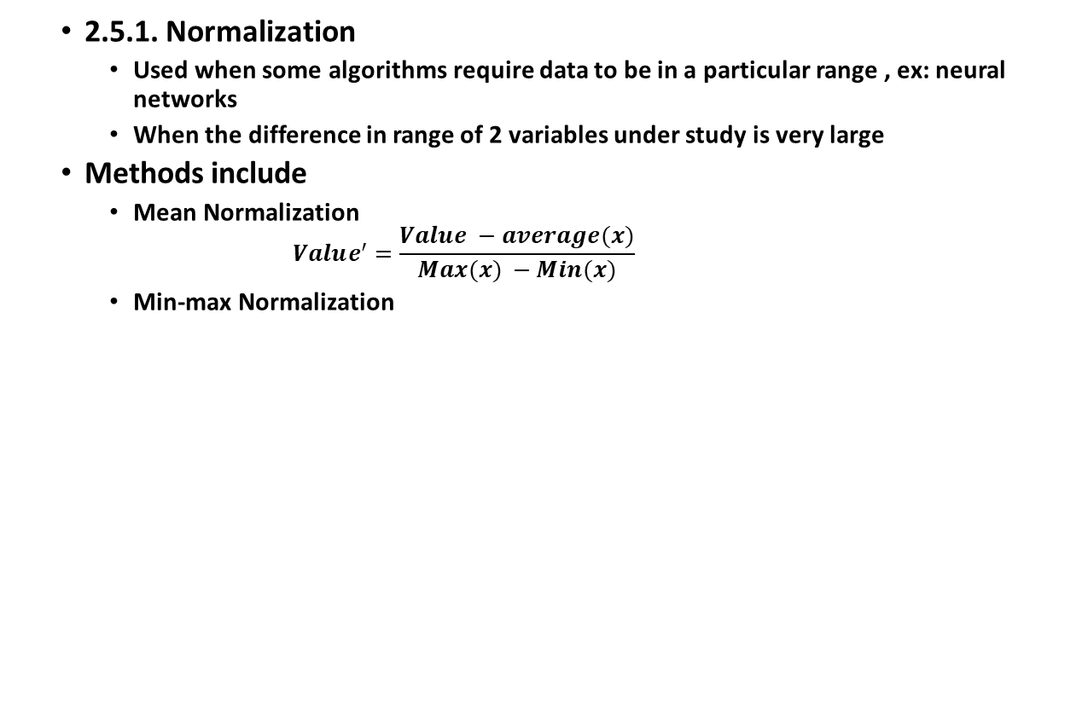
Steps in a data analysis project Step 2 – Data Preparation
2.5.1. Normalization
Used when some algorithms require data to be in a particular range , ex: neural networks
When the difference in range of 2 variables under study is very large
Methods include
Mean Normalization
$$Value^{′}=\frac{Value −average(x)}{Max(x) −Min(x)}$$
Min-max Normalization

Slide 47
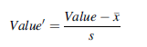
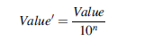
Steps in a data analysis project Step 2 – Data Preparation
2.5.1. Normalization
Used when some algorithms require data to be in a particular range , ex: neural networks
When the difference in range of 2 variables under study is very large
Methods include
Z-score Normalization
Decimal Scaling
(-1 to 1)
n is the number of digits of the maximum absolute value

Slide 48
Example - Normalization
200,300,400,600,1000
Normalize using
Mean Normalization
Min-Max
z-score
Decimal Scaling

Slide 49
Steps in a data analysis project Step 2 – Data Preparation
2.5.2. Value Mapping
To convert ordinal variables described using text values into
Numeric
Binary
2.5.3. Discretization
converting continuous data into discrete values
Method used for numeric attributes
Equal width binning or Equal depth or frequency binning
Cluster Analysis
Example: age into age groups, income into income groups
Methods used for nominal attributes
Specification of a partial ordering of attributes explicitly at the schema level by users or experts
Example : date or location into concept hierarchy
2.5.4. Aggregation
The variable derived from other variables present.
Usually has a mathematical operation
Example : age from DOB

Slide 50
Value mapping

Slide 51
Steps in a data analysis project Step 2 – Data Preparation
2.6. Partition the data
larger data sets take more computational time to analyze
Can create random subset
It should be sufficient to answer the analytical question
Should closely matches the target population
important to note the criteria for subset the data
Models for different data subsets can be created.
A method to consolidate data and results should also be defined

Slide 52
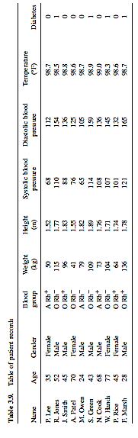
Steps in data analysis projects –Example 1

Slide 53
Example – Data transformation
Create a new column by normalizing the Weight (kg) variable into the range 0 to 1 using the min-max normalization.
Create a new column by binning the Weight variable into three categories: low (less than 60 kg), medium (60–100 kg), and high (greater than 100 kg).
Create an aggregated column, body mass index (BMI)
Segment the data into data sets based on values for the variable Gender

Slide 54
Steps in data analysis projects
Problem Definition
Objectives
Data Preparation
Implementation of the Analysis
Summarizing the data
Deployment
Plan and execute deployment based on the definition in step 1
Deliverables
Roles and responsibilities
Current situation
Timeline
Costs and benefits
Pull together data table
Categorize the data
Clean the data
Remove unnecessary data
Transform the data
Partition the data
Finding hidden relationships
Making prediction
Review the project
Measure and monitor performance

Slide 55
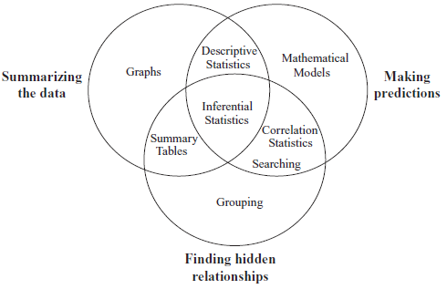
Steps in a data analysis project
Step 3 – Implementation of the analysis
Summarizing the data
Methods include
Summary tables
Graphs
Descriptive statistics
Inferential statistics
Correlation statistics
Finding hidden relationships
Methods include data mining
Market Basket Analysis
Clustering
Making prediction

Slide 56
Steps in data analysis projects
Problem Definition
Objectives
Data Preparation
Implementation of the Analysis
Summarizing the data
Deployment
Plan and execute deployment based on the definition in step 1
Deliverables
Roles and responsibilities
Current situation
Timeline
Costs and benefits
Pull together data table
Categorize the data
Clean the data
Remove unnecessary data
Transform the data
Partition the data
Finding hidden relationships
Making prediction
Review the project
Measure and monitor performance

Slide 57
Steps in a data analysis project
Step 4 – Deployment
analysis is translated into a benefit to the business
Plan and execute deployment based on the definition in step 1
Deliverables could be
Could be static report of the analysis to management or to the customer
Could be a predictive model deployed as standalone or integrated with other software such as spreadsheets or web pages.
Measure and monitor performance
Review the project

Slide 58
References
Glenn J. Myatt, Making Sense of Data: A Practical Guide to Exploratory Data Analysis and Data Mining, John Wiley, November 2006.
Dr Anil Maheshwari, “Data Analytics Made Accessible, 2021 Edition
G. Shmueli, N. R. Patel, and P.C. Bruce, Data Mining for Business Intelligence, John Wiley and Sons, 2010

